Slide 1
Use Case of CarMatch
Course Instructor: Rizwana Noor

Slide 2
Overview
Use case analysis
Finding actors
Identify goals
Functional Requirements
Identify use cases
Identify relationship
Use case Diagram
Usage Scenario

Slide 3
Usecase Analysis
Essential step towards software design and development process to analyze scenario.
So to analyze the case study we have to follow these steps
Identify actors
Identify goals
Identify use cases
Select system boundary

Slide 4
Finding Actors
Actor is an entity that
Interact with the system
Play any role in the system
System should respond to actor
A person, organization, external system, clients
Actors of CarMatch system are as follows:
CarMatch Administrator
Franchise
Webserver
Accountant
Credit card system/company
Automated bank transfer system

Slide 5
Cont.
Actors are named according to their goals or functionality in the system.
Clerk
Receptionist CarMatch Administrator
Supervisor
However, some roles are not always clear from the scenario or case study, you have to do a little brainstorming.

Slide 6
Identify Goals
Goals are basically the functional requirements of the system.
Goals are the functions performed by the roles/actors of the system.
There are some goals performed by different actors.
Actors | Goals
Car Match Administrator | Register car sharer, Manually add car sharer, Match car sharer, Record sharing agreement
Franchise | Register car sharer, Match car sharer,

Slide 7
Functional Requirements
Functional requirements specify all the fundamental actions of the system.
Functional requirements are written in the following way:
FR1: Register a car sharer manually and add car sharer web services.
FR2: If car sharer is registered through web services then transfer car sharer from web server.
FR3: Match the car sharer on geographical basis.
FR4: Pay membership fee for getting car sharer facility if user is added manually

Slide 8
Identify Usecases
Use cases are the actions or functions within the system.
They are named on the basis of function which describes the behavior of the system being implemented.
Some of the Usecase identified in CarMatch system are:
Register Car Sharer
Manually Add Car Sharer
Match Car Sharer
Record Sharing Agreement

Slide 9
Identify Relationship
Usecases of CarMatch system have the following relationship between them
UC1 | Relationship | UC2
Register Car Sharer | Generalization | Manually Add car Sharer, Transfer Car sharer from web server, Add car sharer web service
Manually Add Car Sharer | Include | Process Payment
Process Payment | Extend | Process Card Payment, Process Direct Debt

Slide 10
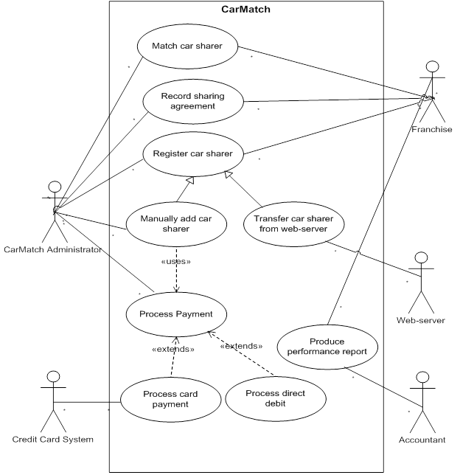
Use Case Diagram

Slide 11
Usage Scenario
Use case title | Process Payment
Usecase Id | CM-PP-06
Requirement Id | FR4
Description | This use case is for processing of payment, when a new user gets the facility of car sharing then he/she has to pay some registration charges.
Pre Conditions: | Administrator must have entered all information about new user in the system. Car sharer must be matched.
Notes:
CM-PP-06 *
Carmatch , payment process , 06

Slide 12
Cont.
Task Sequence | Exceptions
1. Administrator adds a new car sharer account. | System may show authorization exception
2. System asks for necessary information.
3. Administrator provides all the required information and selects to complete the operation. | System may show record duplication error. Systems may show mandatory fields not filled exception. If no record is entered , system may show NULL exception.
4. There is a problem in the data provided; some data needs to be corrected. Administrator checks the available information and corrects the error. Administrator continues from the step 3.

Slide 13
Cont.
Task Sequence | Exceptions
5. System after confirmation register the new car sharer. | System may show user authentication exception
6. System ask for processing of payment (membership fee), if franchise successfully matched the new car sharer to available transport.
Post Conditions: Sharing agreement must be recorded. Payment of membership fee is processed.
Authority: Administrator
Modification history: 1.0 Author: <Project or Group ID>

